Slide 1

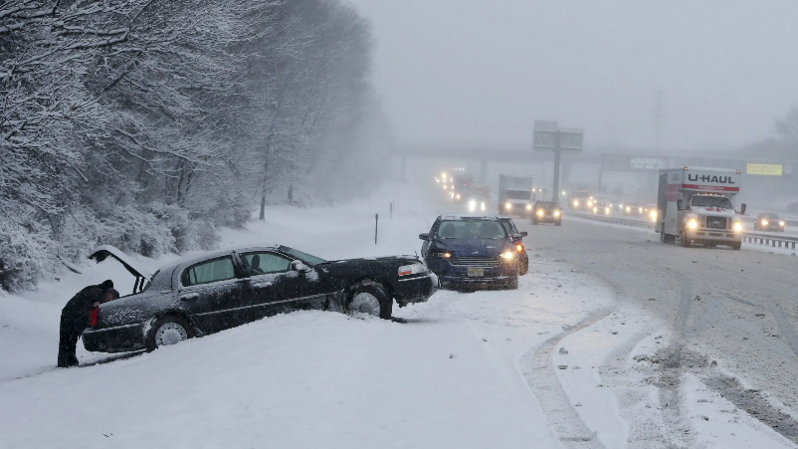
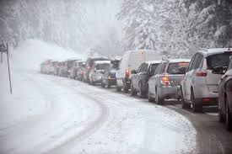

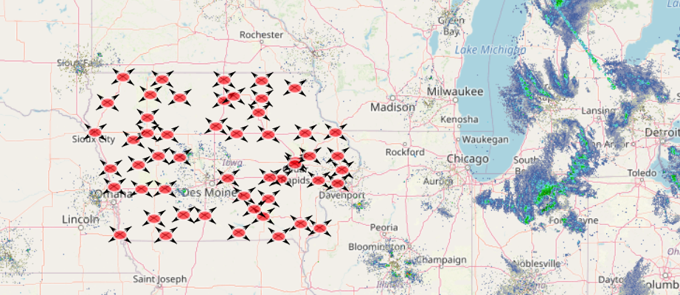
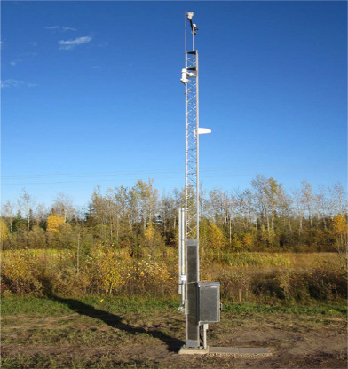

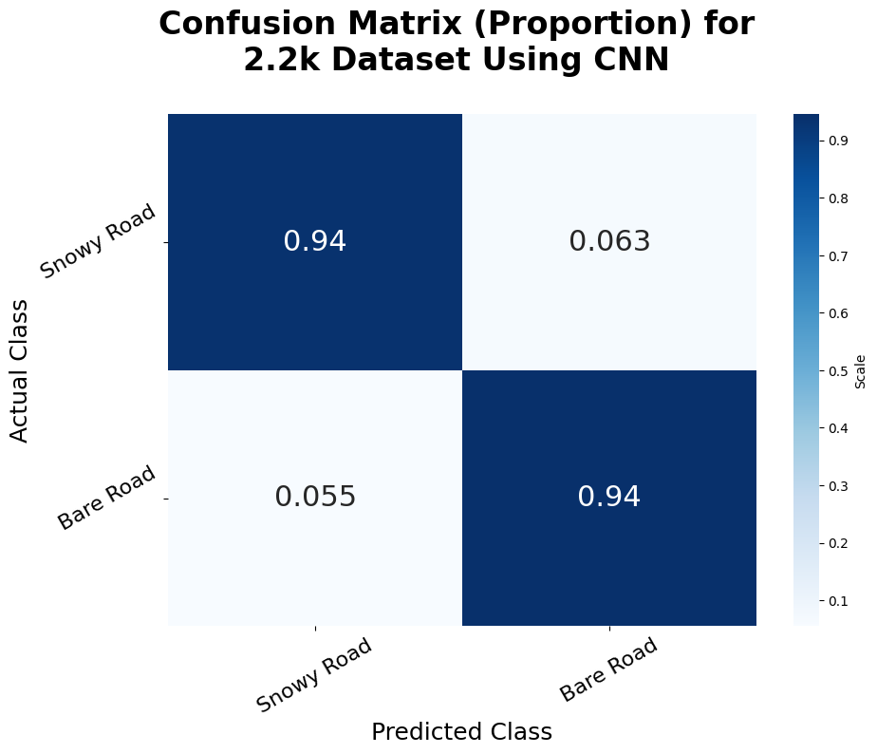
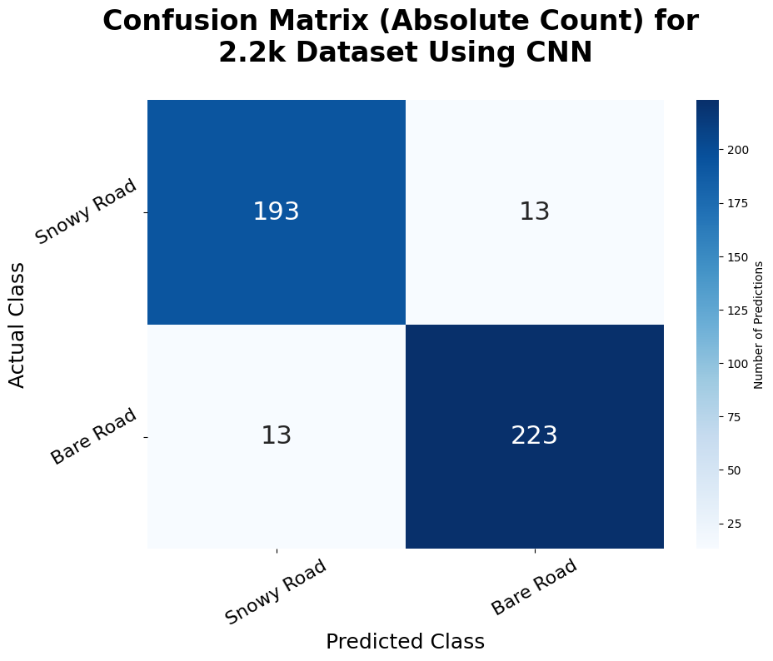


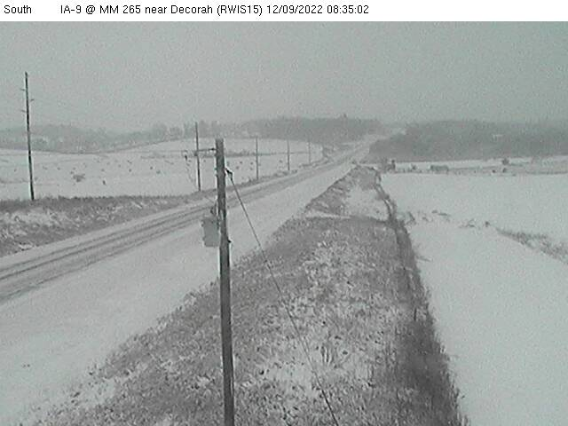
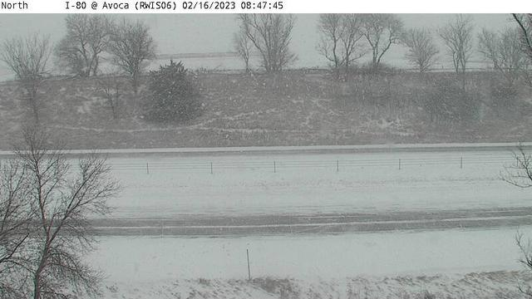
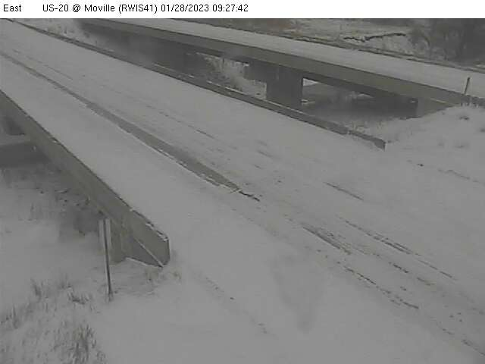

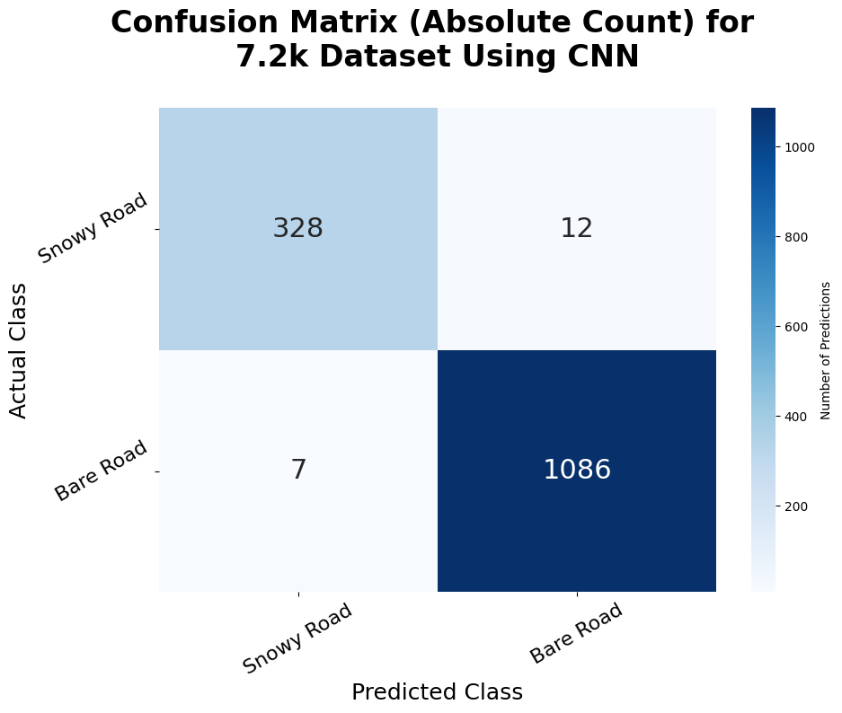
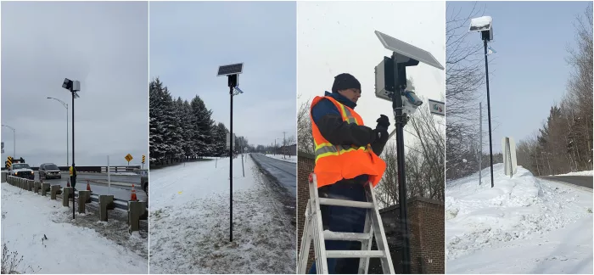
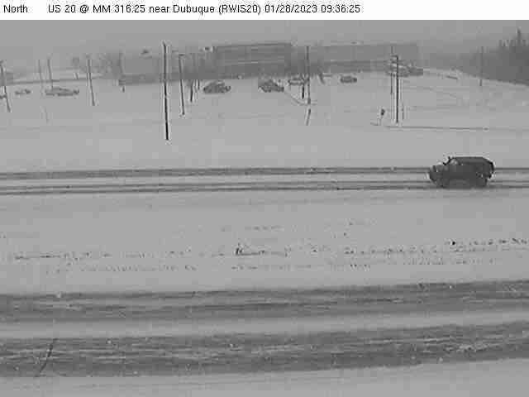
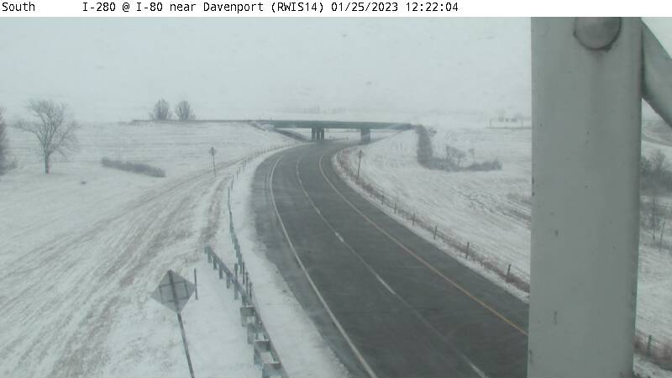
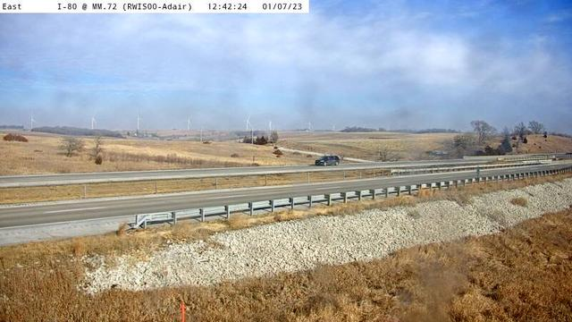
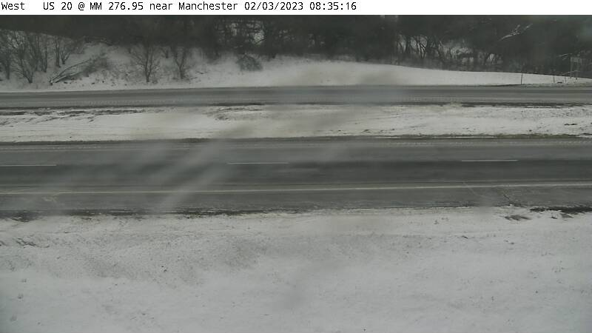
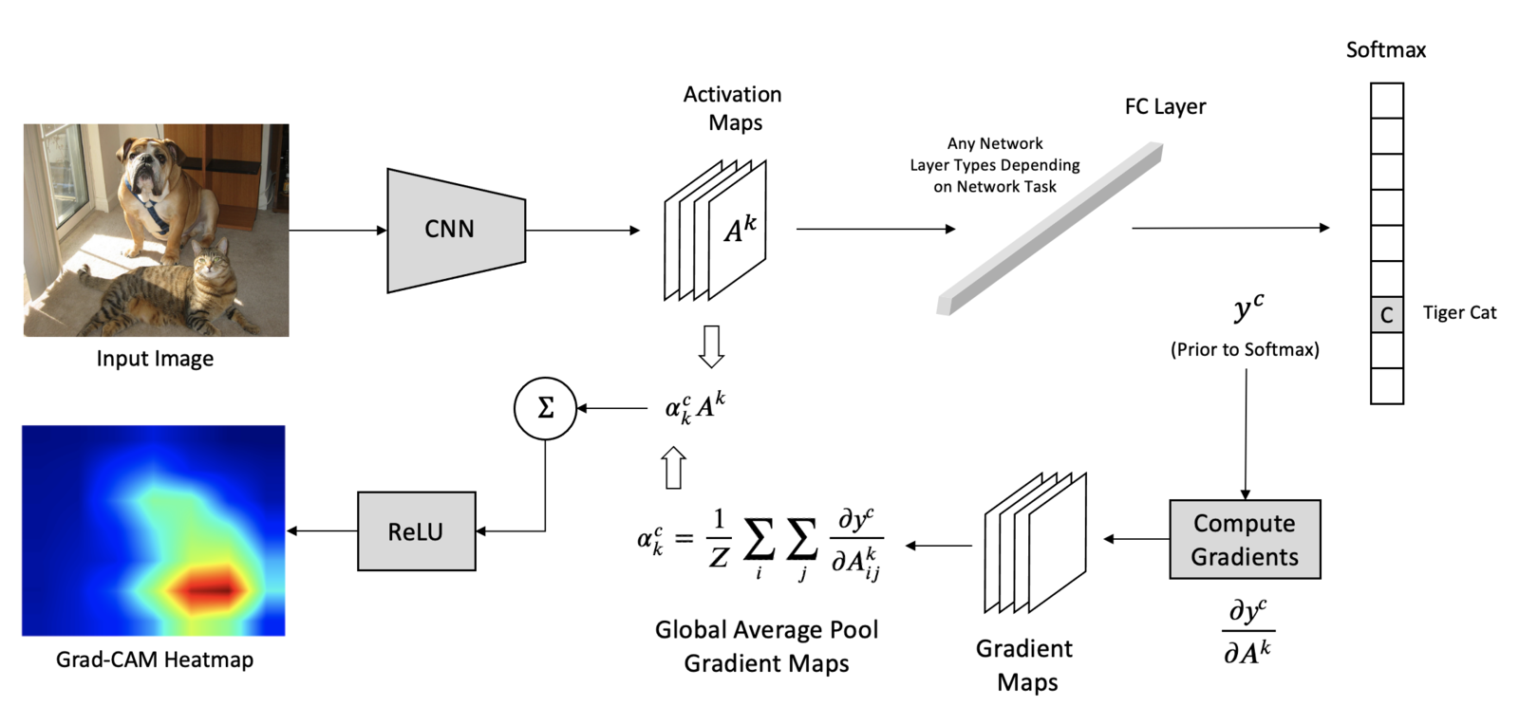
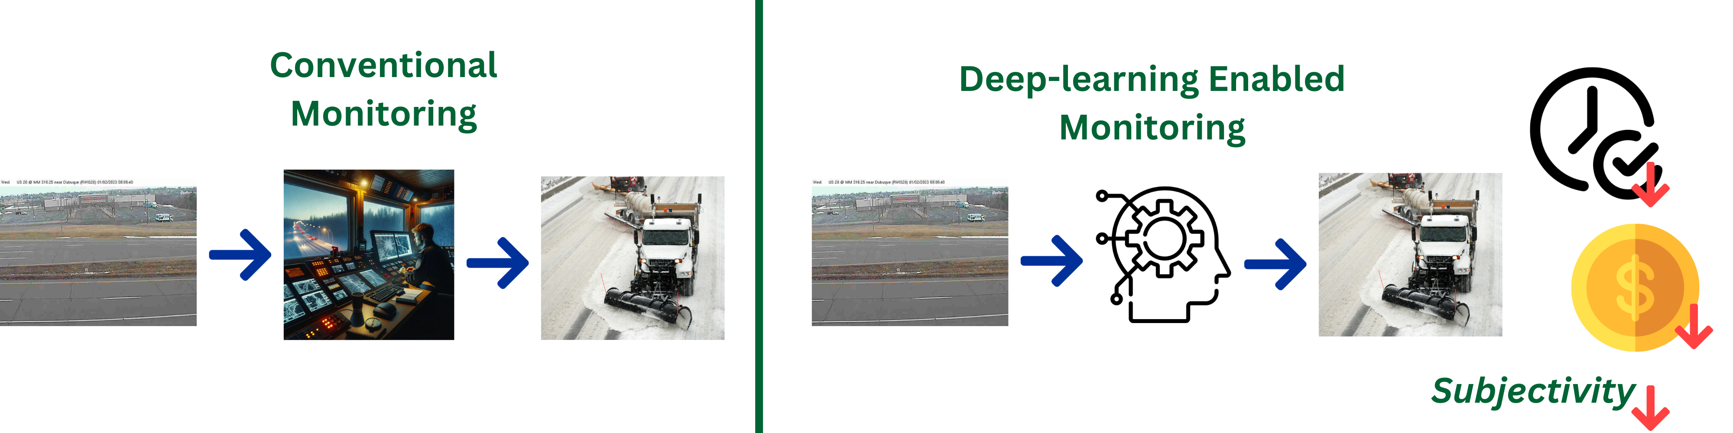
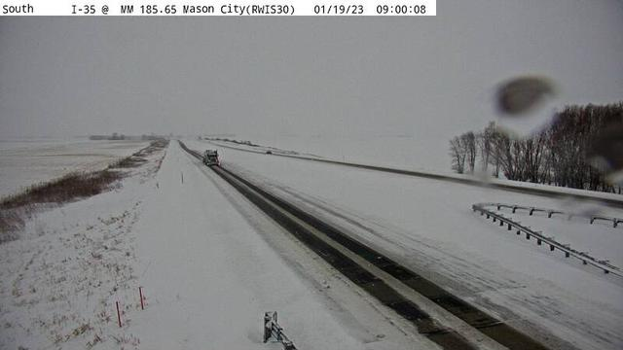
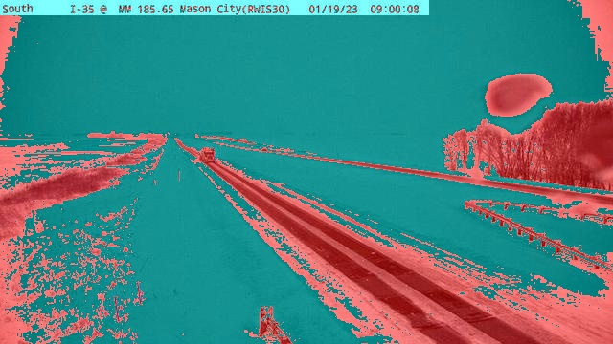
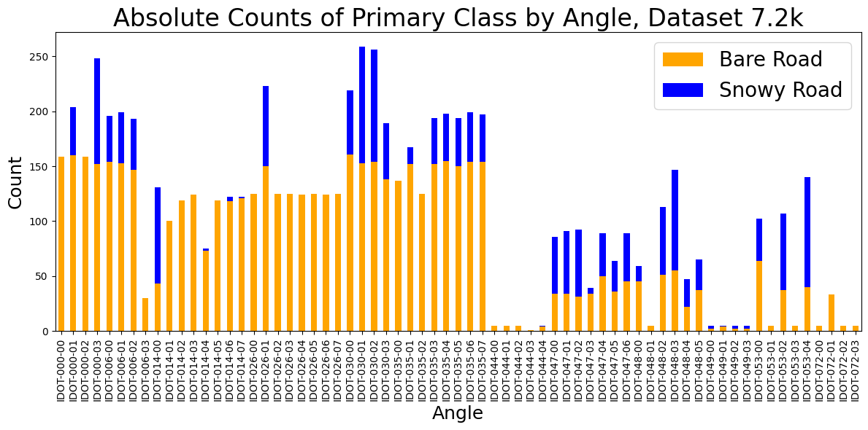
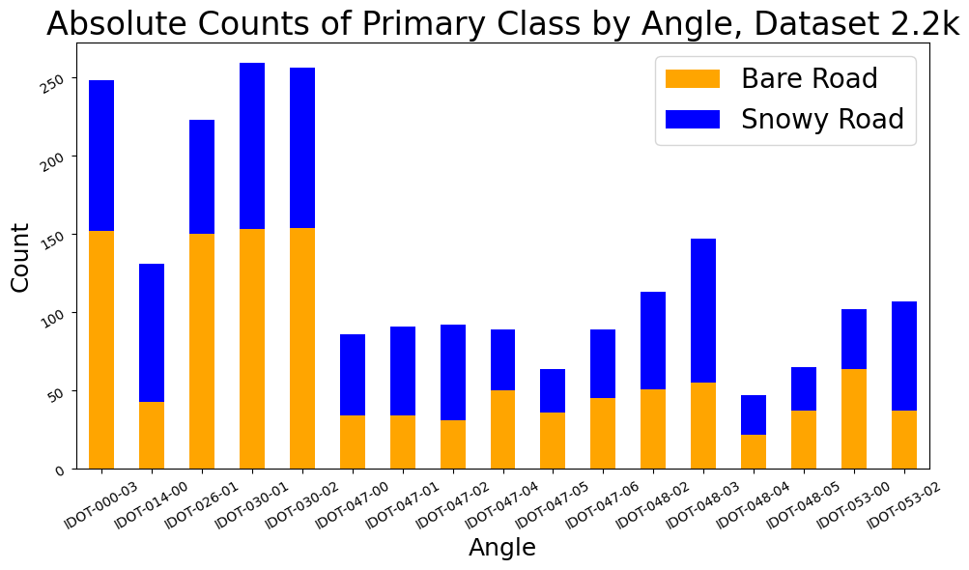
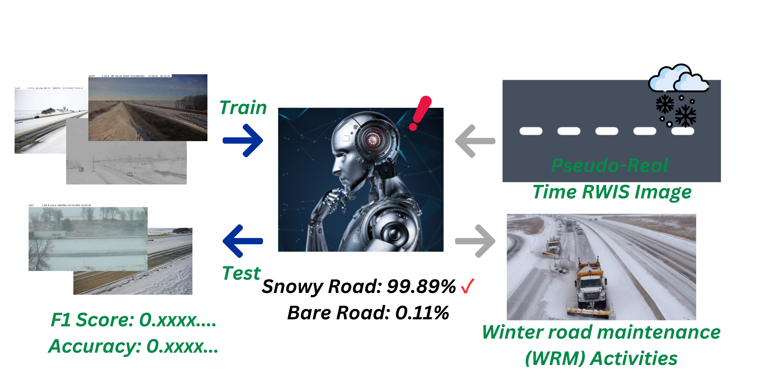
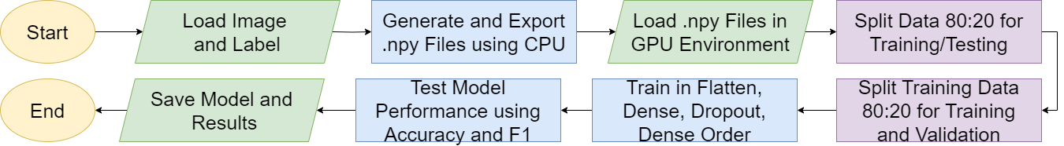
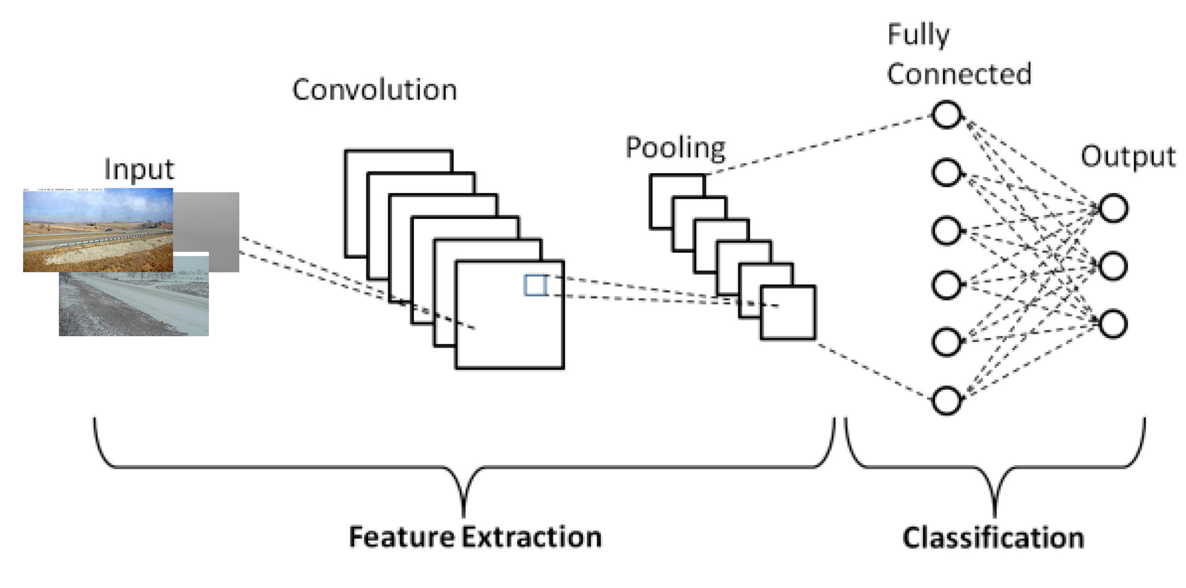
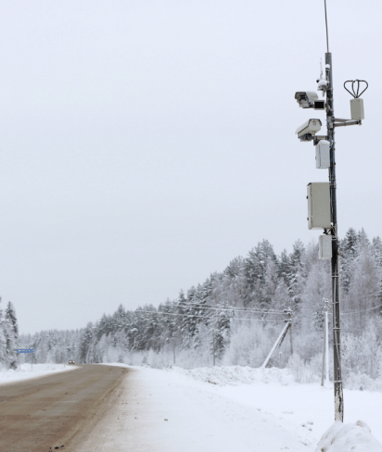
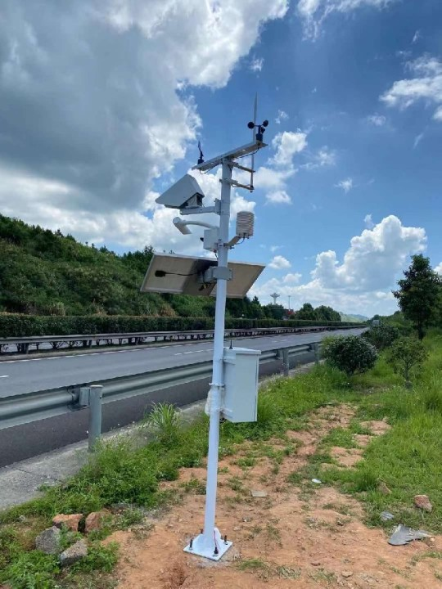


CNN-based Deep Learning-Enabled Tool for Winter Roadway Condition Monitoring
Yong Lee¹, Mingjian Wu², Tae J. Kwon³
¹Dean’s Research Awards Student, ²Graduate Research Assistant, ³Asscoiate Professor
¹Department of Electrical and Computer Engineering & ²,³Department of Civil and Environmental Engineering, University of Alberta, Edmonton, AB, Canada, T6G 2W2
Introduction & Background
Methodology
Results
Introduction ​​
Winter challenges road safety and mobility with snow and ice, necessitating effective maintenance strategies. While Road Weather Information Systems (RWIS) equipped with cameras have improved the monitoring of road conditions, the manual analysis of Road Surface Conditions (RSC) captured by these cameras is still time-inefficient and labour-intensive.
Background ​ ​​
Advances in artificial intelligence and computer vision allow for the automated monitoring of RSC through RWIS image analysis. This enables real-time monitoring and reduces labor costs, which are vital for improving road safety and efficiency during winter.
Study Area & Data Collection ​
Performance Evaluation and Results Analysis ​
Work Zone
21% of All Vehicle Crashes are
Weather-related in U.S.
Winter Traffic Mobility Capacity 44%↓
Speed 17%↓
Winter Maintenance Annual Cost In U.S.
Direct $2.3B Indirect $5B
Iowa RWIS Location
Stationary RWIS
Dec 2022 – Feb 2023
Image Labelling ​
Snowy
Road
Bare
Road
RWIS Database:
Camera Data
Traffic Data
Atmospheric Data
Surface Data
Grad-CAM: Visual Explanations via Gradient-based Localization ​
Comparison of Unbalanced and Balanced Image Datasets ​
Grad-CAM enhances CNN interpretability by highlighting image regions most influential in classification, such as snow or bare pavement, offering insights into model decisions and improvement areas.
Objectives
Conclusions
Unbalanced 7,164 Images (7.2k)
67 Individual Angles
Balanced 2,200 Images (2.2k)
17 Individual Angles
A CNN-based deep learning model was developed to automate RSC recognition from stationary RWIS images, demonstrating high accuracy in training and validation. Its success not only proves its precision in identifying RSC but also showcases its potential in advancing towards a pseudo-real-time road condition monitoring system, offering significant cost and labor reductions in road safety operations.
Training & Testing with Convolutional Neural Networks (CNN) ​
Acknowledgement
Convolution
Pooling
Fully Connected
……..
Input
Output
The authors extend their gratitude to the Faculty of Engineering for the support provided through the Dean’s Research Awards Program. This program has been crucial in facilitating this study by providing a platform and the necessary opportunities for research. Additionally, the authors wish to acknowledge the Iowa Department of Transportation for supplying the essential datasets necessary for our research.
Highway
Snowy
Residential
Bare
Snowy
Snowy
Bare
Bare
​The objective is to improve winter road monitoring with Convolutional Neural Networks (CNN) to enable near real-time RSC monitoring by interpolating between RWIS points.
Feature Extraction
Classification

